Slide 1
Self-Deception as Protective Emotion Regulation Strategy
Gabby Cordelli
Central Study: “Self Deception as Affective Coping” (Meta-Analysis) (Lauria, Preismann, Clément, 2015)

Slide 2
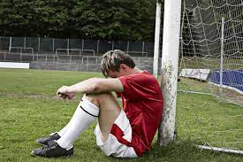

Defining Deception
Self-Deception: intentionally forming a belief that conflicts with another belief within an individual; denial
The Sam and Mary Scenario
Interpersonal Deception: intentionally inducing in others a belief that the deceiver does not hold
Sam in the Sam and May Scenario

Slide 3
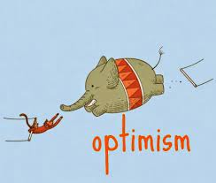
Self-Deception in Psychology
Little Direct Study…
Studies on unrealistic optimism (Heatherton & Wagner, 2011)
Studies on Drug Addiction Relating Dopaminergic Systems and PFC inhibition (Crews & Boettiger, 2009)

Slide 4


Why Do We Self-Deceive?
Protection from the negative somatic marker associated with the true belief
Favoring the dopamine producing event
Somatic Marker Hypothesis, “Gut Feelings” and Dopamine
(a) appraisal of the strength of evidence as uncertain, (b) low coping potential and (c) negative anticipation along the lines of Damasio’s somatic marker hypothesis

Slide 5
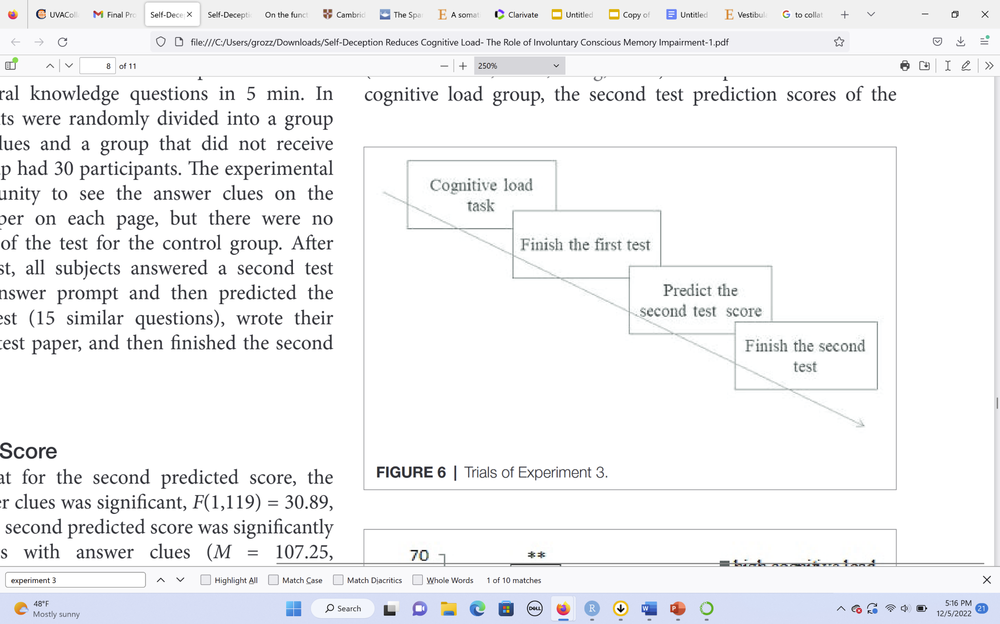
Article: “Self-Deception Reduces Cognitive Load: The Role of Involuntary Conscious Memory Impairment ”
“Self-deception is so undeniable a fact of human life that if anyone tried to deny its existence, the proper response would be to accuse this person of it. (Allen Wood, 1988 )”
Low Cognitive Load vs High Cognitive Load
Answers Provided vs Not Provided

Slide 6
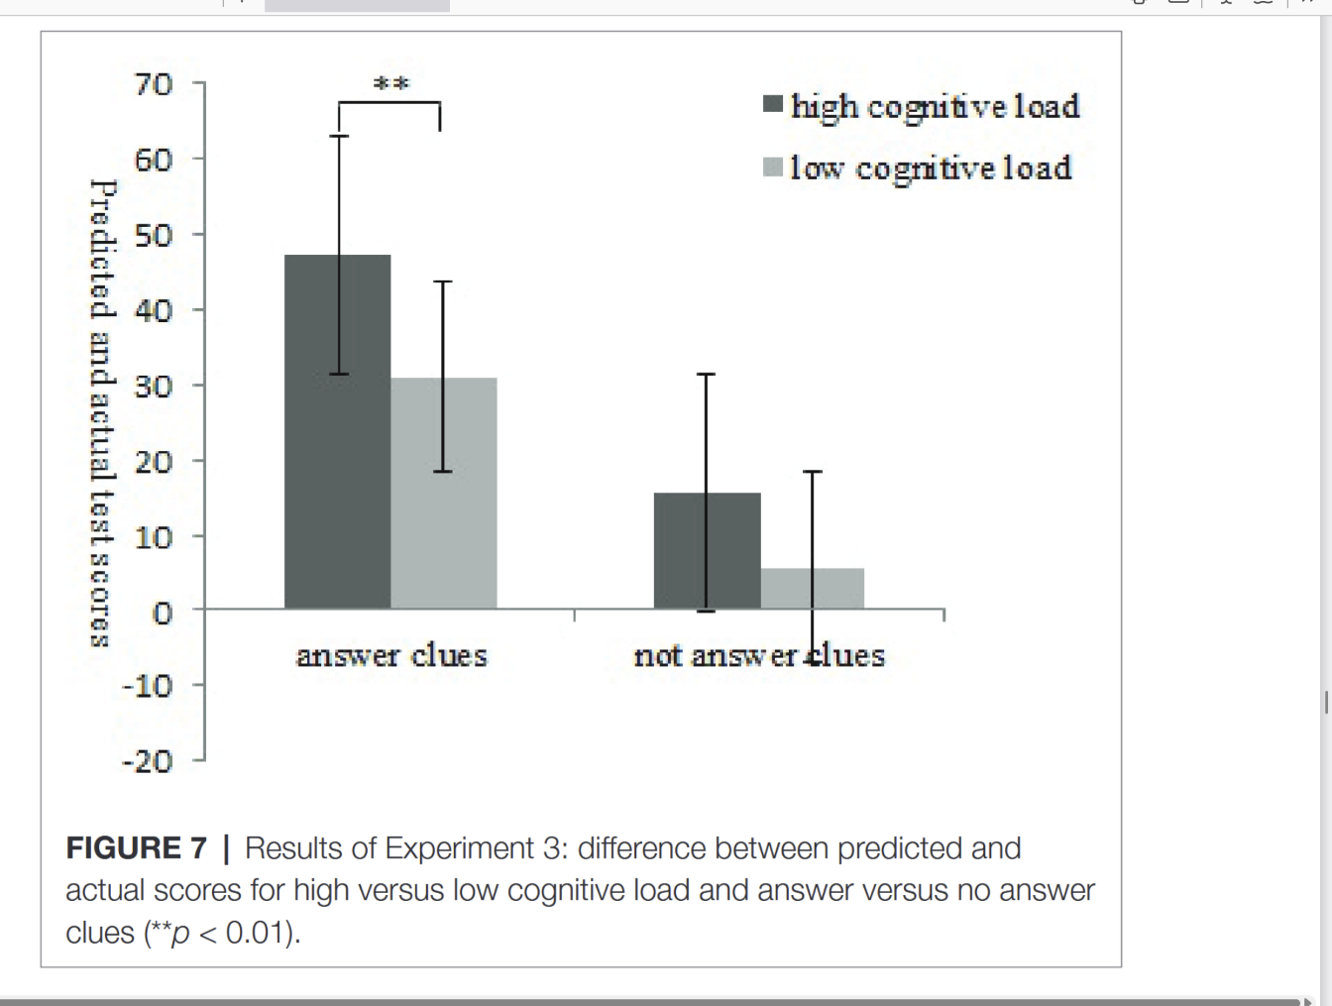
Results of Cognitive Load and Answer Presentation on Score Prediction

Slide 7
Citations
Federico Lauria, Delphine Preissmann, Fabrice Clément, Self-deception as affective coping. An empirical perspective on philosophical issues, Consciousness and Cognition, Volume 41, 2016, Pages 119-134, ISSN 1053-8100, https://doi.org/10.1016/j.concog.2016.02.001.
Ryan McKay, Corinne Tamagni, Antonella Palla, Peter Krummenacher, Stefan C.A. Hegemann, Dominik Straumann, Peter Brugger, Vestibular stimulation attenuates unrealistic optimism, Cortex, Volume 49, Issue 8, 2013, Pages 2272-2275, ISSN 0010-9452, https://doi.org/10.1016/j.cortex.2013.04.005.
Todd F. Heatherton, Dylan D. Wagner, Cognitive neuroscience of self-regulation failure, Trends in Cognitive Sciences, Volume 15, Issue 3, 2011, Pages 132-139, ISSN 1364-6613, https://doi.org/10.1016/j.tics.2010.12.005.
Jian Z, Zhang W, Tian L, Fan W and Zhong Y (2019) Self-Deception Reduces Cognitive Load: The Role of Involuntary Conscious Memory Impairment. Front. Psychol. 10:1718. doi: 10.3389/fpsyg.2019.0171

